Slide 1

Integrating Freshmen into Exploring the
Multi-faceted World of Engineering
& Sustainability through
Biofuels Synthesis from Waste Cooking Oil
Justinus A. Satrio ¹ , Laura-Ann Chin¹ , Kenneth A. Kroos²
¹ Department of Chemical Engineering
&
²Department of Mechanical Engineering
Villanova University
Villanova, PA 19085
Presented at
2015 Pennsylvania Environmental Resources Consortium (PERC) Workshop
Teaching About Climate Change
January 9th, 2015
Susquehanna University. Selingrove, PA 17870

Slide 2
What’s different today in education??
Background
Students today need a reason and motivation to buy into an engineering education.
Inviting and creative approach is needed early on

Slide 3
Engineering Interdisciplinary Project Courses
EGR 1200
EGR 1205
Freshman Mini Project #2
1st quarter
2nd quarter
3rd quarter
4th quarter
Core course: Fundamentals & Micro-projects
7 weeks
7 weeks
7 weeks
7 weeks
Fall Semester
Spring Semester
Freshman Mini Project #1
Discipline Specific Introductory Course

Slide 4
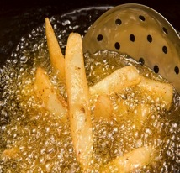
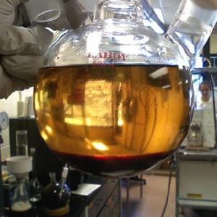
Biofuels Process & Sustainability
A Freshman Engineering Mini Project
Waste Cooking Oil
Biodiesel Synthesis from
Waste Cooking Oil &
Use of Glycerol By-product for Soap Production
Biodiesel + Glycerol byproduct

Slide 5
Motivation
Expose young freshmen to the latest changes and issues in society
Respond to our reliance on non-renewable fossil fuels that have rapidly depleted, causing negative impacts on our environment
Help students to have early-on awareness of the role of engineering profession related to sustainability development

Slide 6

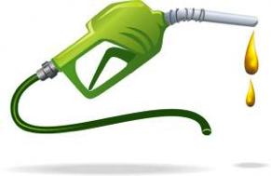
GOALS
To learn aspects of Bioeconomy:
Production of transportation liquid fuels from biorenewable materials
Sustainability issues related to how biofuels are produced and utilized
SPECIFIC GOALS
Use of engineering and chemistry principles to synthesize & characterize biodiesel from a renewable resource (Waste cooking oil from VU’s Dining Services)
Use experimental data to evaluate process performances
Assess overall sustainability of production process
Notes:
Bioeconomy : attain vital sources of carbon and energy from biorenewable materials, such as biomass

Slide 7
GOALS
To learn aspects of sustainability:
Current sustainability/environmental issues
Options in responding to sustainability/environmental issues
SPECIFIC GOALS
Understand various aspects in sustainability concepts
Develop awareness about the impacts of individual and society
Develop knowledge on strategies and program activities that can be done to improve sustainability by reducing environmental impacts.
Notes:
Bioeconomy : attain vital sources of carbon and energy from biorenewable materials, such as biomass

Slide 8
Learning Activities
Week
1 | Introduction to concepts of sustainability. Sustainability and carbon footprint: how much CO₂ does my household emit per year? Work using carbon footprint calculator
2 | Sustainability in biomass to biofuels processes Biodiesel production process: process concept and chemistry Preparation to go to the lab
3 | Laboratory experiment #1: Biofuel synthesis and experimental data collection In class: Introduction to the concept of mass and energy balance and heat transfer phenomena
4 | Laboratory experiment #2: Biofuel characterization and experimental data collection In class: Analyze data and use data to prepare a report on energy and heat transfer

Slide 9
Learning Activities
Week
5 | Laboratory experiment #3: Utilizing byproduct: soap making from glycerin by-product In class: Analyze data and use data to prepare report on chemistry and mass balance
6 | Lecture and in-class activity: Concept of entrepreneurship (in collaboration with Undergraduate Engineering Entrepreneurship program) Working on poster
7 | Final presentations: poster and final reports

Slide 10
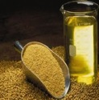
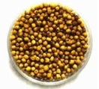

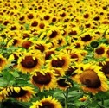
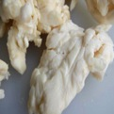

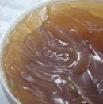
Fundamental Concepts in
Biodiesel Synthesis
Heat Transfer
Mass & Energy Balance
Sustainability & Entrepreneurship
Chemistry
Variation of Feedstocks
Notes:
Talk about different feedstocks and transition into WCO, and how Dining services produces 7000gpy, sustainability: selection of feedstock is important, utilize waste

Slide 11
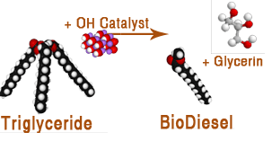
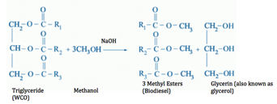
Chemistry Behind Biodiesel Synthesis
Pictorial representation of transesterification reaction of WCO (triglyceride) into biodiesel.
Transesterification of triglycerides to form biodiesel
Molecular weight calculation of oil
Basis for mass balance calculations
Organic chemistry
Catalyzed reaction (Sodium methoxide)
Notes:
MW Calculation of oil, organic chemistry to use as a basis for Mass balance calc, chemistry catalyst (with and without catalyst)

Slide 12
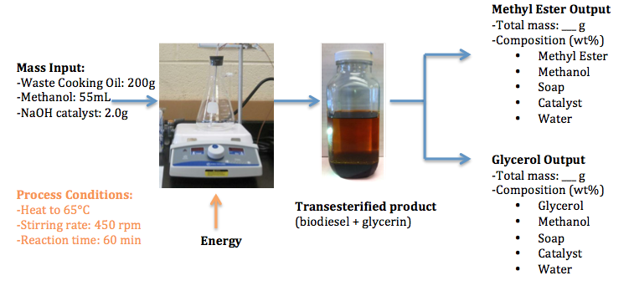
Mass Balance Analysis
Theoretical vs. Experimental Mass Balance

Slide 13
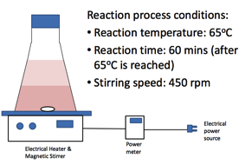
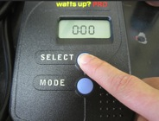
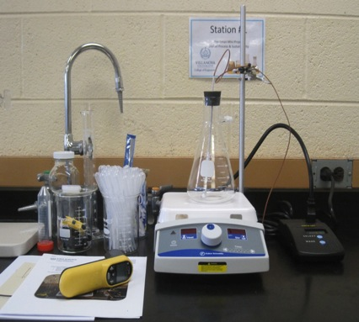

Energy Balance Analysis
Watt meter for
power usage measurement
Infrared thermometer
for temperature measurement
Notes:
Electrical power usage and reaction temperature, transient and steady state

Slide 14
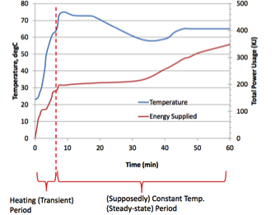
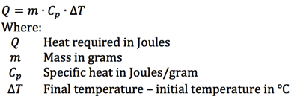
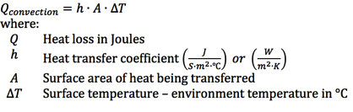
Energy Transfer Analysis
Temperature (°C) and Energy Usage (kJ) Profiles during Biodiesel Synthesis vs. Time (min)
Transient State Analysis
Heat Loss by Convection
Notes:
Heat transfer mechanisms, heat loss in chemical process, engineering assumptions , insulation
Experimental: Transient & Steady Sate
Apply theory to experiment
Power usage & exp data information

Slide 15
General Concepts of Sustainability

Slide 16
Sustainable Development
(United Nations)
How to meet the needs
of the present generation…
…without compromising
the ability of future
generations to meet theirs
  Brundtland Commission - 1987

Slide 17

Sustainability:
The triple bottom line
Society depends on the economy
The economy depends on the global ecosystem, whose health represents the ultimate bottom line.
Current sustainability/environmental issues:
Climate Change or Disruption
Water
Ozone Depletion
Soil Degradation and Food Supply
Species Extinction
Oceans and Fishery Resources
Concentration of Toxics
Depletion and Degradation of Natural Resources
Etc.
Group Discussion
Select 1 or 2 sustainability issues from the list.
For each issue: create a scenario, how the environmental disturbance caused by the issue can affect the economy and how the problem in the economy can impact the society.
Choose the size of the society: local, regional, national or world wide?
Notes:
http://www.sustainability.com/home.asp

Slide 18
How should we respond to environmental/sustainability Issues, such as climate change problems?

Slide 19
Society’s options
Wait and see
(+) no wasted effort
(-) maximizes suffering
Mitigate
(+) reduces risk
(-) may waste resources
(-) some impacts unavoidable
Adapt
(+) better handling of risks
(-) some impacts too severe
Geo-engineer
(+) potential desperation strategy
(-) may trigger big side-effects
(-) some impacts unavoidable
Notes:
So this is a risk management problem. Can’t quantify the risks well but we can do some comparisons. The bigger the risk from climate impacts, relative to the risk of efforts to reduce those risks (i.e., climate impacts) the more effort we should make.
Also reasonable, though not necessarily true, that more aggressive climate policy (mitigation, adaptation, geoengineering) would also pose greater risks to society (energy and transportation costs or unintended consequences).

Slide 20


Stabilization Wedges
A Concept and Game
This presentation is based on the “Stabilization Wedges” concept first presented in
"Stabilization Wedges: Solving the Climate Problem for the next 50 Years with Current Technologies,” S. Pacala and R. Socolow, Science, August 13, 2004.

Slide 21
The Stabilization Triangle
Billions of Tons Carbon Emitted per Year
Easier CO₂ target
16
Current path = “ramp”
~850 ppm
Stabilization Triangle
Interim Goal
8
Historical
emissions
Flat path
Tougher CO₂ target
~500 ppm
1.6
0
1950
2000
2050
2100
Notes:
21

Slide 22
Stabilization Wedges
Billions of Tons Carbon Emitted per Year
16 GtC/y
16
Current path = “ramp”
Eight “wedges”
Goal: In 50 years, same
global emissions as today
8
Historical
emissions
Flat path
1.6
0
1950
2000
2050
2100
Notes:
22

Slide 23
15 Wedge Strategies in 4 Categories
Energy Efficiency &
Conservation (4)
16 GtC/y
Fuel Switching
(1)
Renewable Fuels
& Electricity (4)
Stabilization
Stabilization
Triangle
Triangle
CO₂ Capture
& Storage (3)
8 GtC/y
Forest and Soil Storage (2)
2007
2057
Nuclear Fission (1)
Notes:
23

Slide 24
“Wedge” Stabilization
Group Discussion & Exercise
Choose the top three wedges that you think to be the most promising and discuss the potentials of the wedges from the following perspectives:
  Technical/Engineering Feasibility
  Economics
  Consumer Acceptance
  Political Achievability
  Globalization Potential
Auto Fuel Efficiency
Transport Conservation
Buildings Efficiency
Electric Power Efficiency
CCS—Electricity
CCS—Hydrogen
CCS—Synfuels
Fuel Switching—Natural Gas Power Plants
Nuclear Energy
Wind Electricity
Solar Electricity
Wind Hydrogen
Biomass Fuels
Forest Storage
Soil Storage

Slide 25
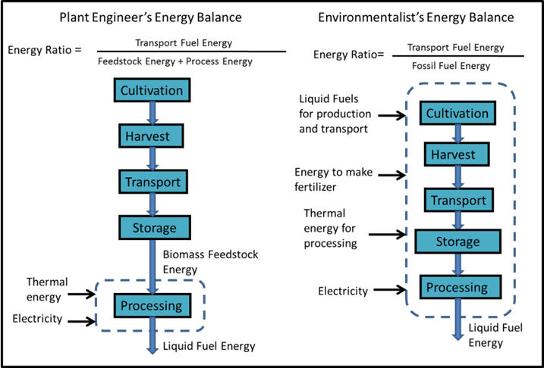
Sustainability of Biofuels Synthesis:
Energy Balances

Slide 26
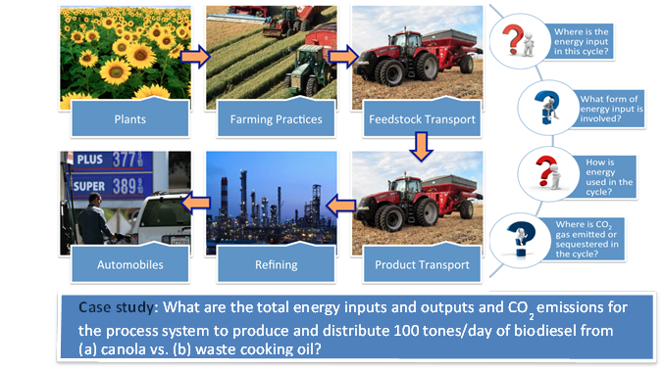
Sustainability of Biofuels Synthesis
Life Cycle Analysis Concept

Slide 27
Samples of Assignments for Preparing Student’s Mindset on Sustainability

Slide 28
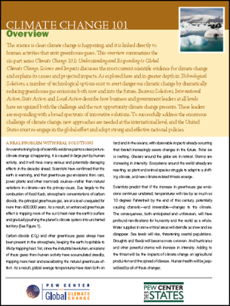
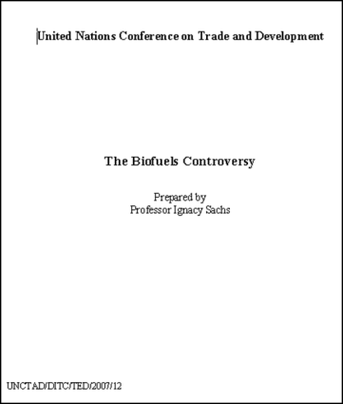
Preparing Student’s Mindset
Read two articles:
  Article 1: Climate Change 101
  Article 2: The Biofuels Controversies
For each article students write a short summary and their thoughts one a particular issue/aspect that interest them the most.

Slide 29
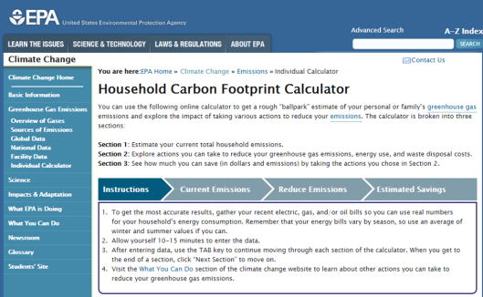
Calculating Carbon Footprint
Baseline Assessment
10% Reduction Scenario
30% Reduction Scenario
50% Reduction Scenario
70% Reduction Scenario
Lessons Learned—Pros and Cons
http://www.epa.gov/climatechange/ghgemissions/ind-calculator.html

Slide 30
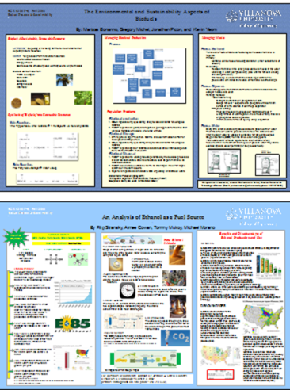
Developing Projects for
Improving Sustainability on Villanova University.
Group assignment: developing projects for improving sustainability on Villanova University campus related to energy and water usages.
Students present their proposed projects in a formal poster session held at the end of the course.
Convey technical information to an audience
Defend work through Q&A sessions
Open to public

Slide 31
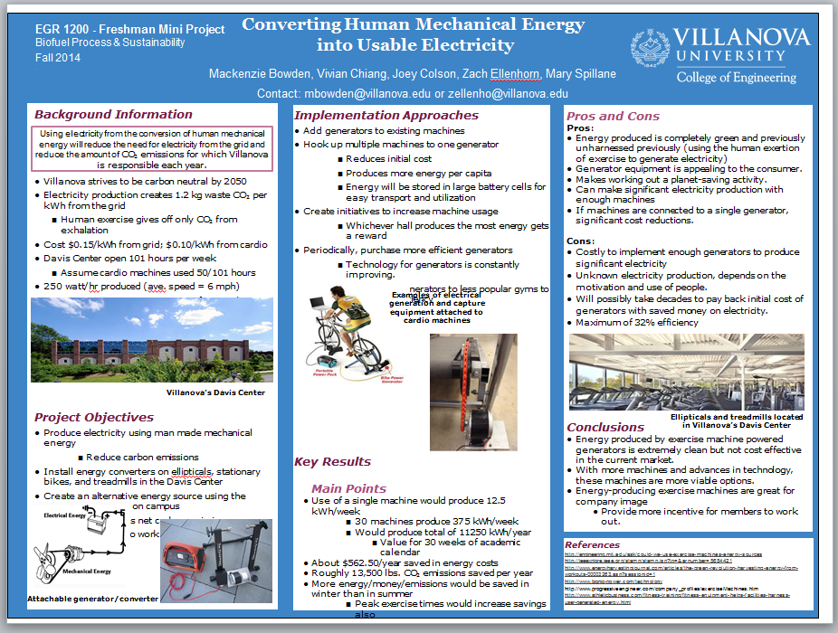
Project # 3

Slide 32
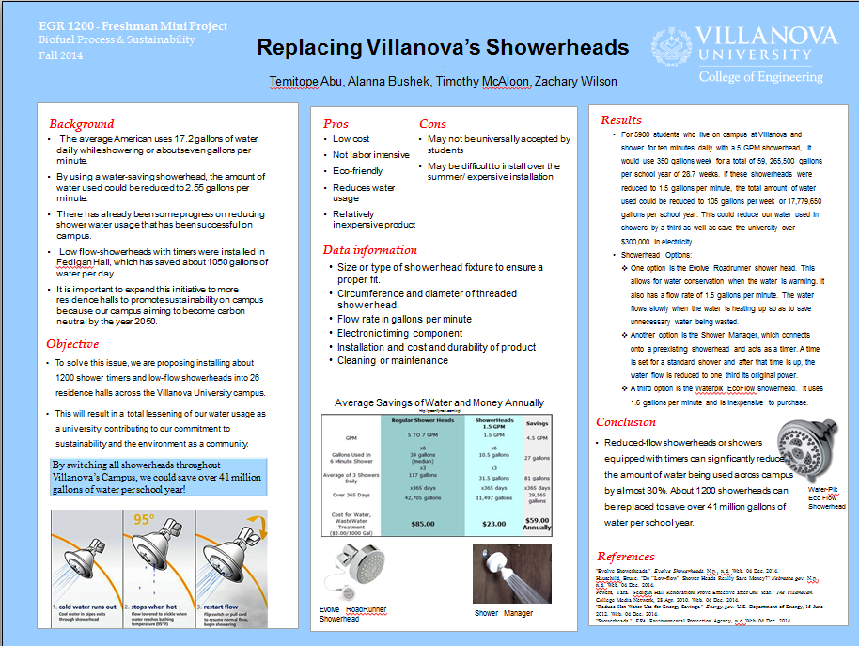
Project # 4

Slide 33
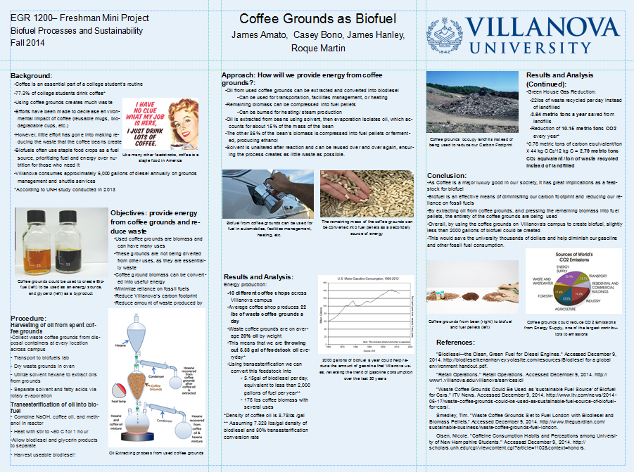
Project # 5

Slide 34
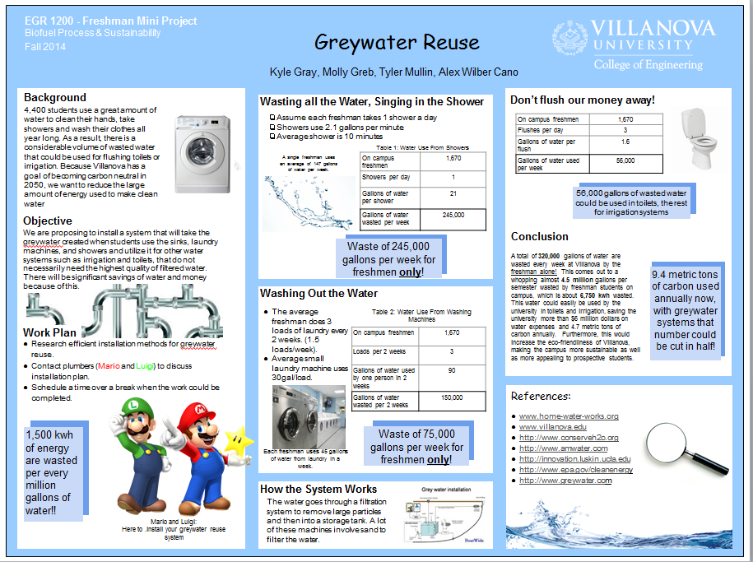
Project # 6

Slide 35
Conclusion
Through multidisciplinary hands-on engineering projects, students will have the opportunity to explore the demands and expectations of engineering and better prepare them for a successful undergraduate career.
Biofuels production & process plant analysis :
highly interdisciplinary engineering effort
Introduce students to a variety of engineering design, development tools & concepts of sustainability
Seed in helping students decide early on and become an all rounder engineer
Notes:
Tie back to goal of project: students buy into education
Cross functional SUSTAINABILTY component common denominator-

Slide 36
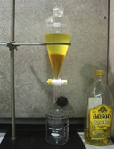
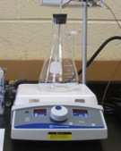
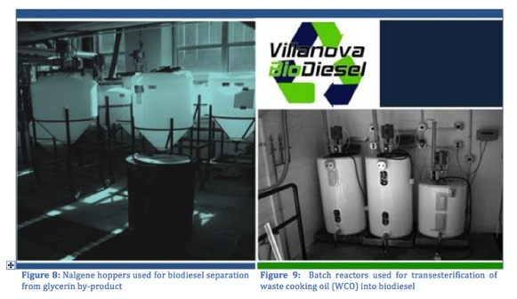
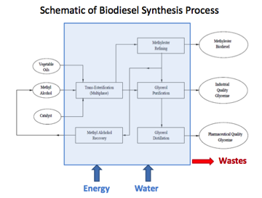
Recruiting Platform for Student-Run
Villanova Biodiesel Program
Scale up of process from lab bench design
Process flow diagrams
3500
Notes:
Scale up of instruments,

Slide 37
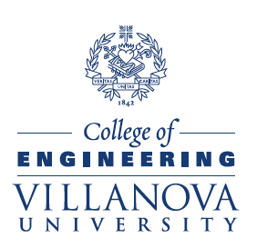
Acknowledgment
Thank you for your attention

Slide 38
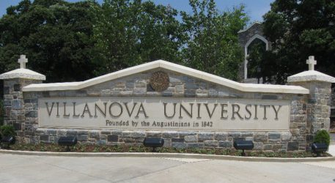
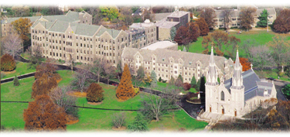
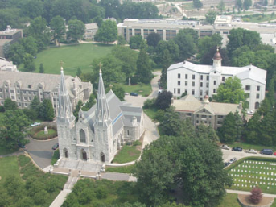

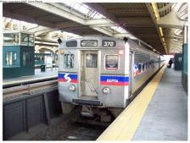

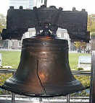

Slide 39
Additional Slides

Slide 40
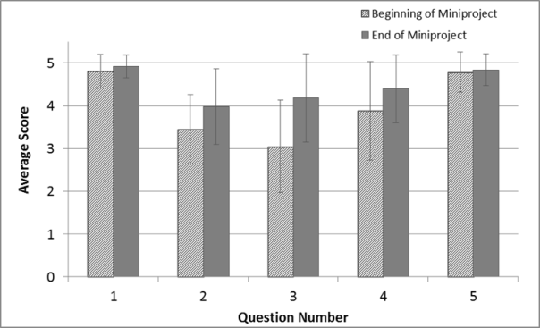
Students’ Responses on awareness about sustainability in general

Slide 41
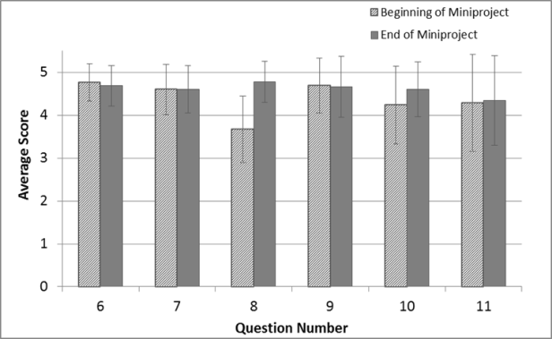
Students’ responses on awareness of engineering in connection to environmental sustainability

Slide 42
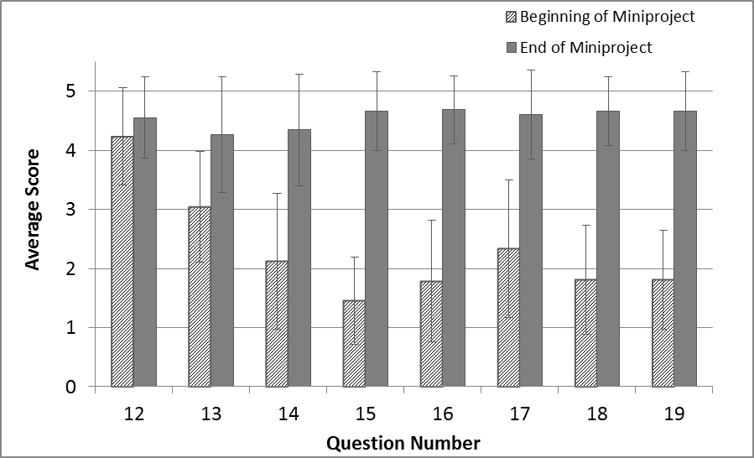
Students’ responses on their levels of technical understanding and knowledge from taking the course.

Slide 43
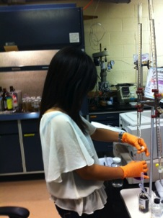
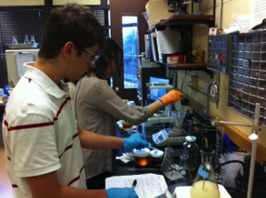
Students’ Responses: Motivation in Choosing Project
Interested in learning about biofuels and/or sustainability
Likes chemistry and want to learn chemistry of biofuel synthesis
Want to learn to make biodiesel and soaps
It sounds fun, “cool” and/or interesting
Want to know if truly interested in chemical engineering

Slide 44
Big Picture: The “Master” Equation
I = P x A x T
I = total environmental impact from human activities
P = population
A = affluence or per capita consumption
T = environmental damage from technology per unit of consumption
Source: Ehrlich and Holdren (1971)

Slide 45
I=PxAxT---Unique Role for the Scientific Profession!!!
In the “Master” Equation, T, is the home domain of the scientific profession
Our critical professional challenge is to reduce T in terms of “environmental impact” per unit of GDP
For I to stay constant, the inevitable increases in P x A must be offset by corresponding reductions in T

Slide 46
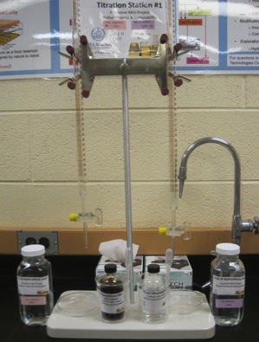
Experimental Setups
Biodiesel synthesis setup
Titration setup

Slide 47
Experimental Setups
Mass balance setup
Soap production setup

Slide 48
About Villanova University
Villanova University, founded in 1842, is the oldest and largest Catholic university in the State of Pennsylvania.
Over 10,000 undergraduate, graduate, and law students, take part in a wide variety of degree programs throughout the University's five colleges – 1) College of Liberal Arts and Sciences, 2) College of Engineering, 2) College of Nursing, 4) School of Business and 5) Villanova School of Law.
COE is ranked in the top 15 in the country by U.S. News & World Report for engineering schools awarding primarily bachelor’s and master’s degrees. COE offers PhD program in Engineering.
Average 240 freshmen in Engineering. Enrollments keep rising.
> 94% freshman-to-sophomore retention rate.
~ 90% graduation rate

